Slide 1
Kelas IMK Minggu 8
Anny Yuniarti

Slide 2
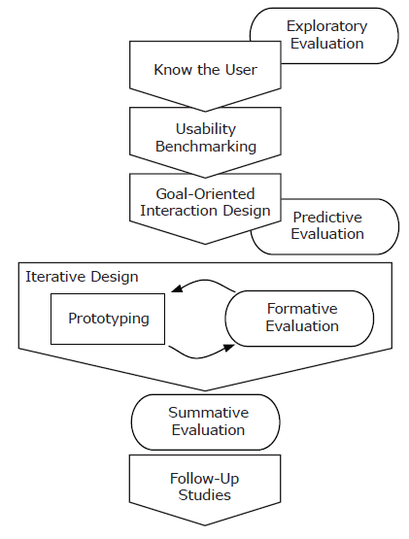
Review: The Usability Engineering Lifecycle

Slide 3
Review: Usability Benchmarking
how usable is the competition?
how much better should your interface be?
what is your likely return on investment?

Slide 4
Review: The Interaction Design Process
Interview
Interview users
Create
Create personas
Define
Define their goals
Create
Create concrete scenarios
Move
Move to a design solution

Slide 5
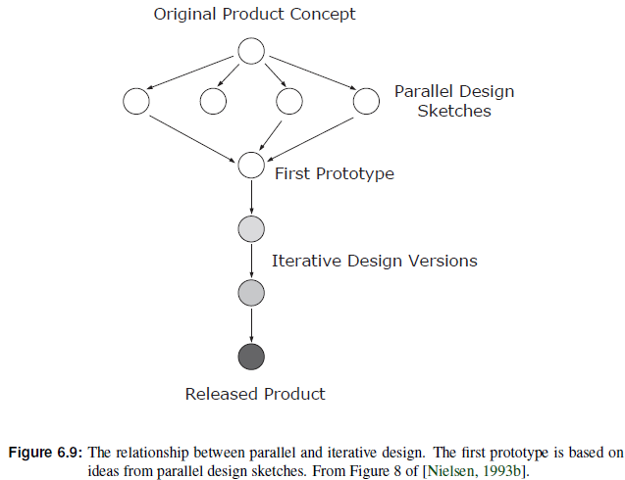
Moving to a Design Solution
Parallel Design
If time and resources allow, explore design alternatives.
Have several design teams work independently, then compare draft designs

Slide 6
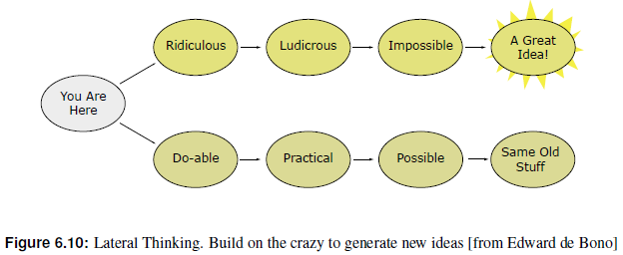
Moving to a Design Solution
Brainstorm
Meet away from usual workplace (different building, hut in the mountains).
Brainstorm with mixed team (engineers, graphic designer, writer, marketing types, usability specialist, one or two representative users).
Use plenty of paper. Cover the walls with it!
Draw. Scribble. Use lots of coloured pens.
Be stupid.
Go crazy, build on the insane, think laterally.
Three rules during brainstorming:
No one is allowed to criticise another’s ideas.
Programmers must not say it can’t be implemented.
Graphic designers must not laugh at programmers’ drawings.
Only after brainstorming, organise ideas and consider their practicality and viability

Slide 7
Exercise
Lakukan usability benchmarking pada aplikasi tim Anda dengan menjawab pertanyaan berikut:
how usable is the competition?
Analyse competing products or interfaces
how much better should your interface be?
Set Usability Targets
what is your likely return on investment?
Use assumptions

Slide 8
Exercise
Continue with your team work on the application
Do you have primary and secondary personas?
Do you need separate interfaces?
Define goals and scenarios for each persona!
Design the interface of your app!
In your report, mention which approach you took to design the interface, i.e parallel design, brainstorming, etc.
Also, did you took surveys on users? What conventions you followed, what design pattern you used?

Slide 9

Prototyping

Slide 10


Prototyping
Perform usability evaluation and obtain feedback as early as possible in the design cycle by building and evaluating prototypes.
Finally, throw prototypes away and implement final design.

Slide 11
Types of Prototype
In increasing order of complexity:
Verbal Prototypes: textual description of choices and results.
Paper Prototypes:
Low-Fidelity: hand-drawn sketches.
High-Fidelity: more elaborate printouts.
Interactive Sketches: interactive composition of hand-drawn sketches.
Working Prototypes: interactive, skeleton implementation.
Then, throw prototypes away and implement final design.

Slide 12
Low-Fidelity Paper Prototypes
Paper prototypes simulate screen and dialogue elements on paper.
First hand-drawn sketches (lo-fi), later perhaps more elaborate printouts (hi-fi).
Early usability feedback with throwaway designs: maximum feedback for minimum effort!

Slide 13
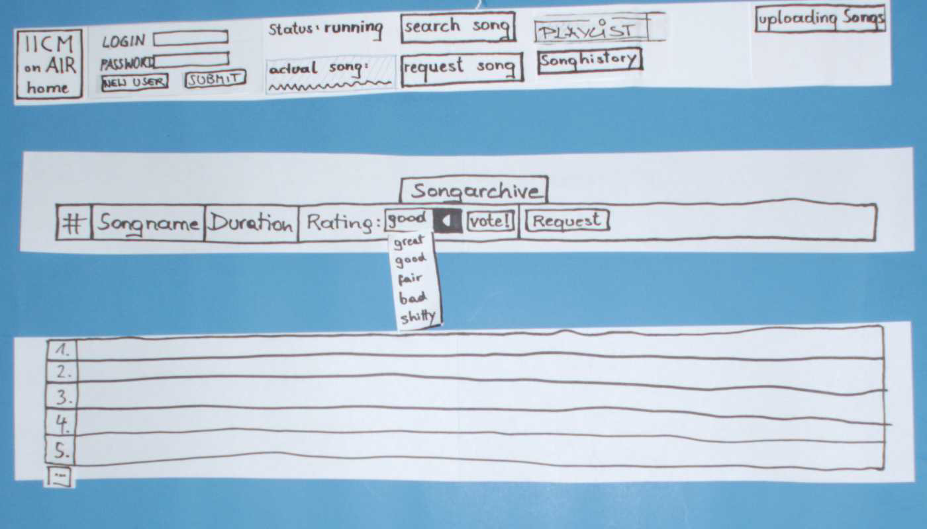
Low-Fidelity Paper Prototypes

Slide 14
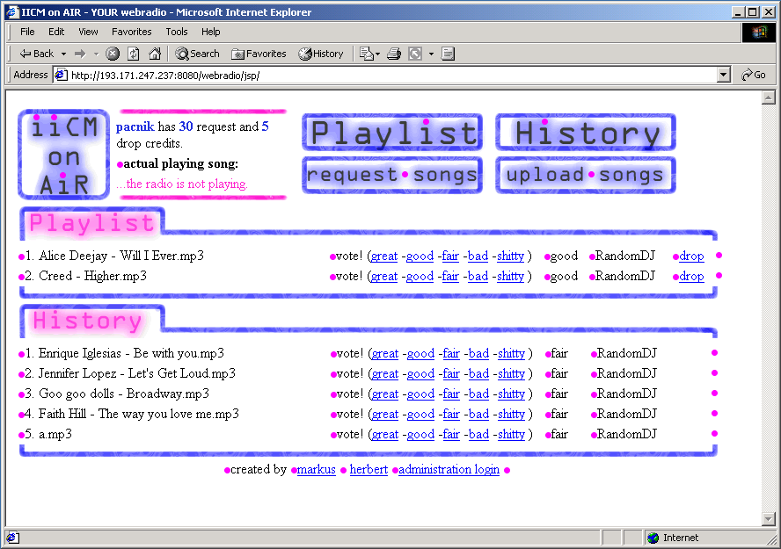
Working prototype

Slide 15
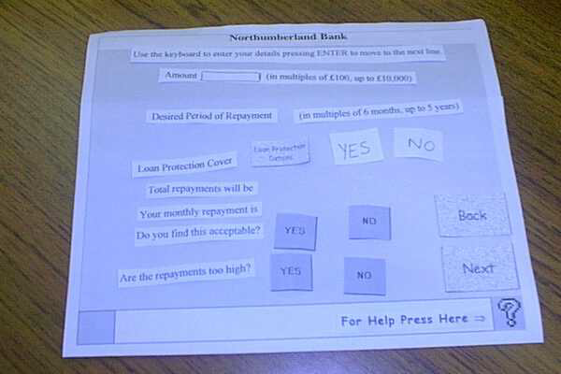
Paper Prototype of Customer Information Terminal
Paper prototype 1 for a customer information terminal

Slide 16
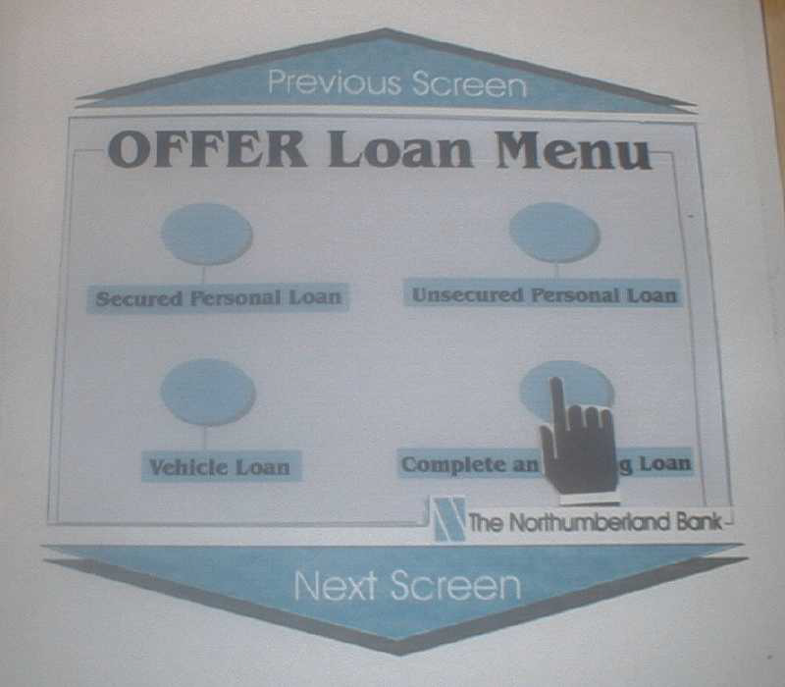
Paper Prototype of Customer Information Terminal
Paper prototype 2 for a customer information terminal.

Slide 17
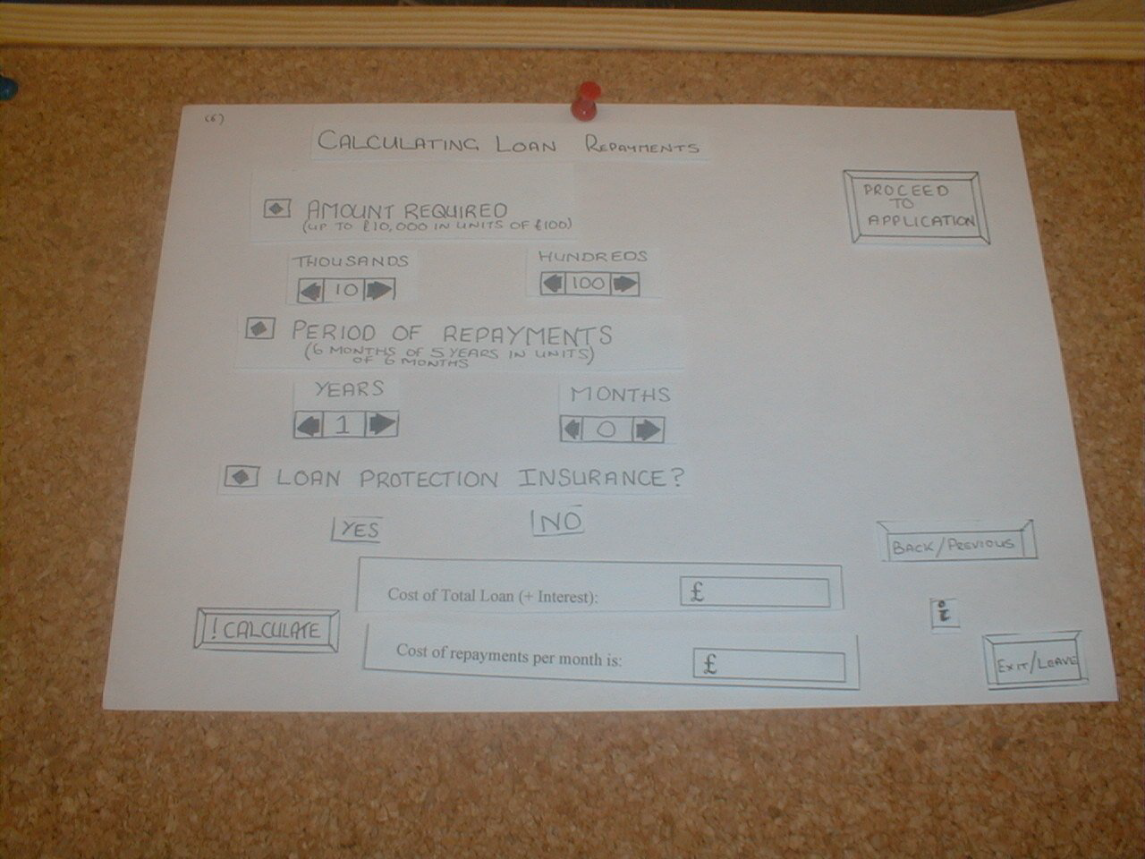
Paper Prototype of Customer Information Terminal
Paper prototype 3 for a customer information terminal.

Slide 18
High-Fidelity Paper Prototypes
Elaborate screen designs created with drawing editors such as Adobe Illustrator or Corel Draw.
Printed out in colour.
They often look too much like a finished design, and not enough like a prototype.
Users tend to comment on the choice of fonts and colours, rather than the flow through the application.

Slide 19
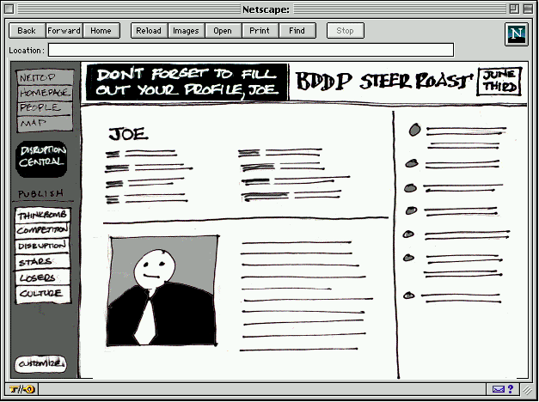
Interactive Sketches
Scan in hand-drawn interface sketches.
Assemble interactive prototype with clickable elements (say with Macromedia Director).
Retains throwaway, casual look to encourage criticism and discussion
An interactive sketch made in Shockwave. Screen designs sketches are scanned and assembled into an interactive prototype with Macromedia Director.

Slide 20
Working Prototypes
Simple algorithms: ignore special cases.
Fake data: similar data, images instead of video, etc.
Wizard of Oz: human expert operating behind the scenes to simulate interface responses.

Slide 21
Prototyping Tools
DENIM
Axure
Balsamiq Mockups
Microsoft Expression
HotGloo

Slide 22
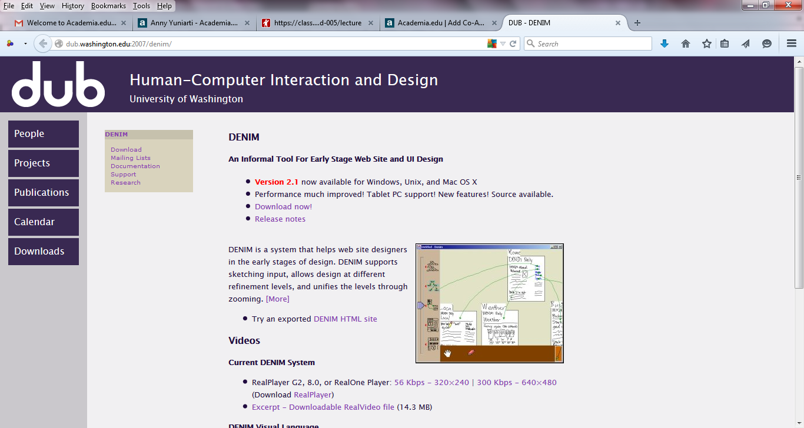
Prototyping Tools
http://dub.washington.edu:2007/denim/

Slide 23
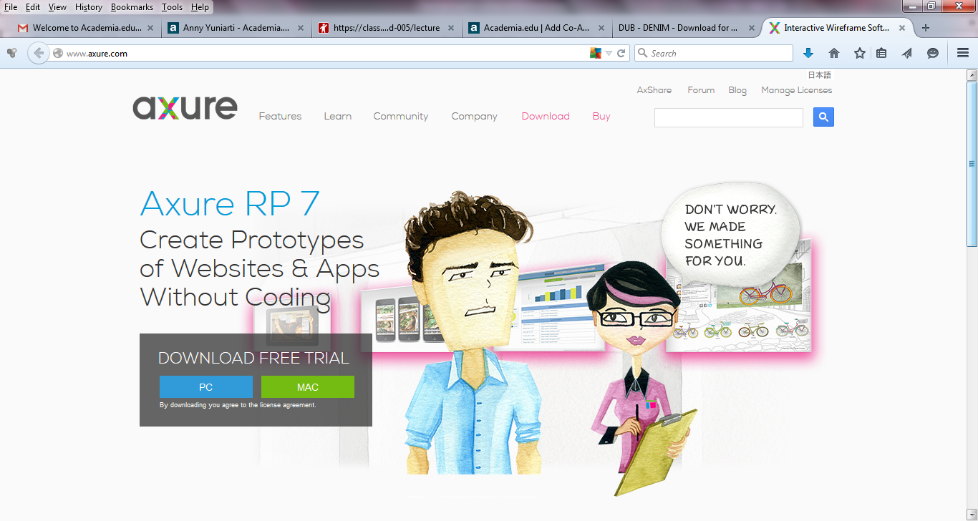
Prototyping Tools
http://www.axure.com/

Slide 24
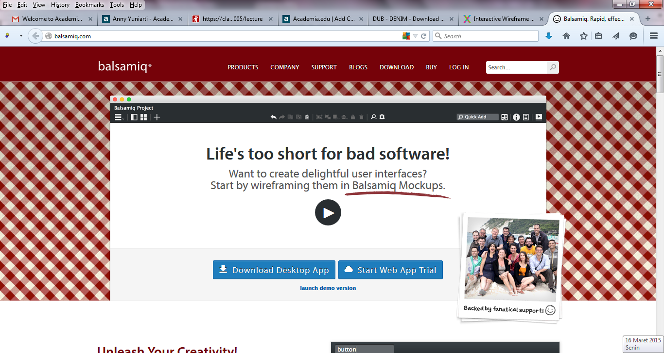
Prototyping Tools
http://balsamiq.com/

Slide 25
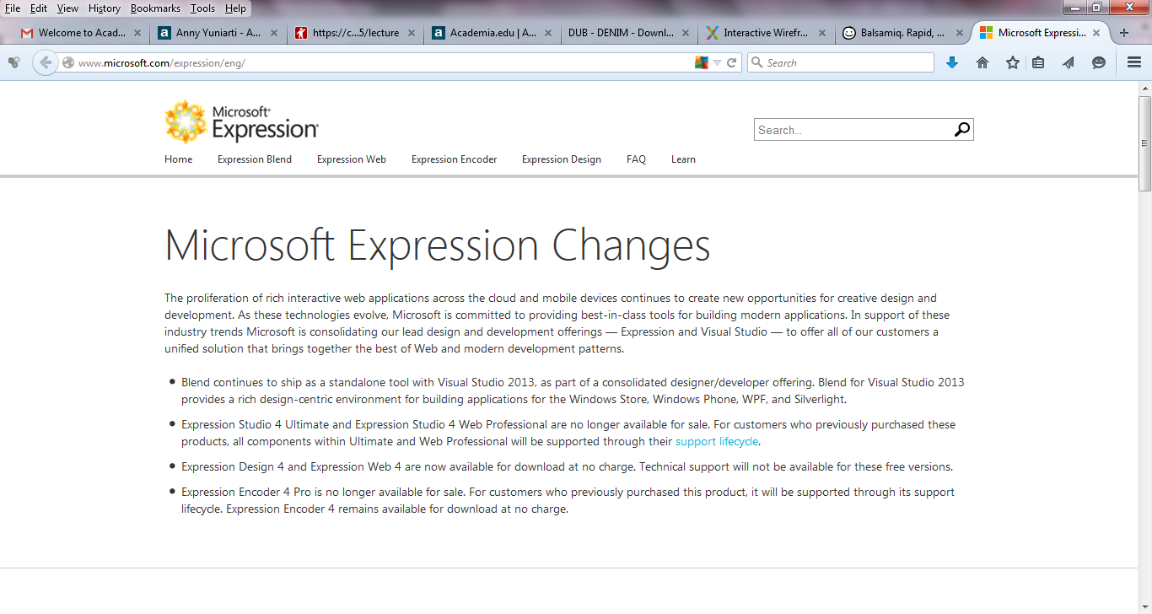
Prototyping Tools
http://www.microsoft.com/expression/eng/

Slide 26
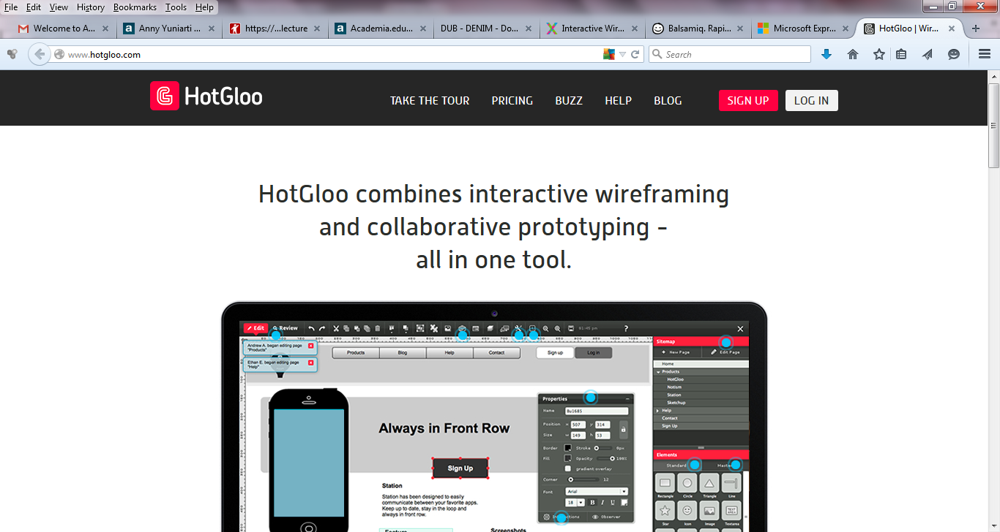
Prototyping Tools
http://www.hotgloo.com/

Slide 27
Dimensions of Working Prototypes
Working prototypes cut down on either the number of features, or the depth of functionality of features:
Vertical Prototype: in-depth functionality for a few selected features.
Horizontal Prototype: full interface features, but no underlying functionality.
Scenario Prototype: only features and functionality along the specific scenarios or paths through the interface which are to be evaluated.

Slide 28
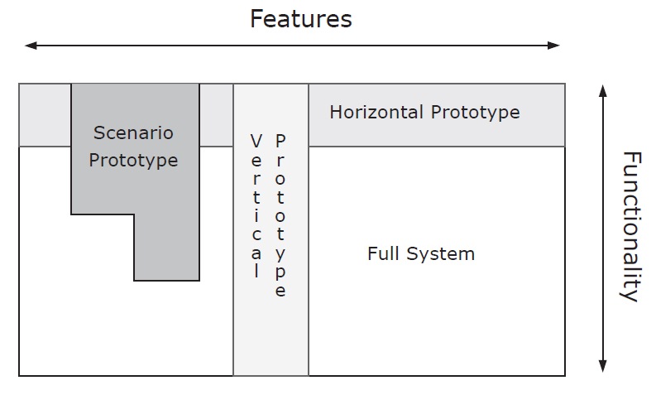
Dimensions of Working Prototypes

Slide 29
Implementation
Implement final design.
Competitive analysis of software components:
Use existing interface framework as far as possible (Motif, MS-Windows, Java Swing) – saves a lot of work.
Use existing components and applications rather than re-inventing the wheel.

Slide 30
Exercise
Build an interactive working prototype of your app
Choose one prototyping tool to develop the prototype
Choose whether it is a vertical, horizontal, or scenario prototype

Slide 31
